Slide 1
Graph Algorithms – Part 3
CPT212 – Design & Analysis of Algorithms

Slide 2
Learning Outcomes
In this topic, we will:
Learn about additional properties of digraphs and associated algorithms
Reachability
Connectivity
Cycle detection
Transitive closure

Slide 3
Digraph Properties

Slide 4
Recap – Digraph Definition
A graph G=(V,E) such that
Each edge goes in one direction:
Edge (a,b) goes from a to b, but not b to a
E
D
C
B
A

Slide 5

Example Digraph Application
Scheduling: An edge $(a,b)$ means task $a$ must be completed before task $b$.
CPT112
CPT111
CPT113

Slide 6
Reachability
DFS tree rooted at v: vertices reachable from v via directed paths
Draw the DFS trees rooted at C.
E
D
C
F
A
B

Slide 7
Reachability
Draw the DFS trees rooted at B.
E
D
C
F
A
B

Slide 8
Strong Connectivity
Each vertex can reach all other vertices
a
g
c
d
e
b
f

Slide 9
Strong Connectivity Algorithm
Pick a vertex v in G
Perform a DFS from v in G
If there’s a w not visited, print “no”
Let G’ be G with edges reversed
Perform a DFS from v in G’
If there’s a w not visited, print “no”
Else, print “yes”
Try: Perform DFS for the following graph starting from a!
a
g
c
d
e
f
b

Slide 10
Strong Connectivity Algorithm
Pick a vertex v in G
Perform a DFS from v in G
If there’s a w not visited, print “no”
Let G’ be G with edges reversed
Perform a DFS from v in G’
If there’s a w not visited, print “no”
Else, print “yes”
Try: Flip the edges and perform a DFS starting from a.
a
g
c
d
e
f
b

Slide 11
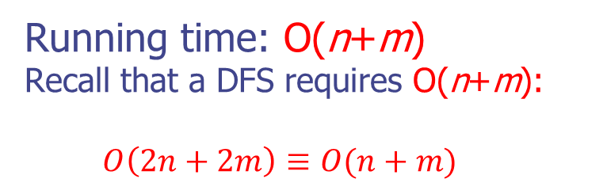
Example
G:
a
c
g
d
e
b
Result: Yes Graph is strongly connected.
f
a
G’:
c
g
d
e
f
b
Running time: O(n+m)
Recall that a DFS requires O(n+m):
$$O\left(2n+2m\right)≡O(n+m)$$

Slide 12
Task
Remove one edge such that the graph is no longer strongly connected
a
g
c
d
e
b
f

Slide 13
Example Solution
Remove one edge such that the graph is no longer strongly connected
a
g
c
d
e
b
f

Slide 14
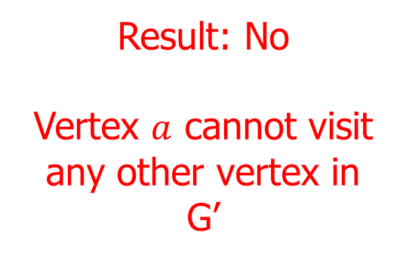
Example
G:
a
c
g
d
e
Result: No Vertex $a$ cannot visit any other vertex in G’
f
b
a
G’:
c
g
d
e
f
b

Slide 15
Strongly Connected Components
A strongly connected component is a subgraph such that each vertex can reach all other vertices in the subgraph
Draw one example of a strongly connected component
a
g
c
d
e
f
b

Slide 16
Strongly Connected Components
Maximal subgraph is the largest possible subgraph such that each vertex can reach all other vertices in the subgraph
Is this a maximal sub-graph?
a
No, because b cannot reach g.
g
c
d
e
f
b

Slide 17
Cycle Detection for Digraph
digraphCycleDetectionDFS(v)
num(v) = i++;
for all vertices u adjacent to v
if num(u) is 0
pred(u) = v;
digraphCycleDetectionDFS(u);
else if num(u) is not ∞
pred(u) = v;
cycle detected;
num(v) = ∞;
a b c
d e f
g h
(∞,f)
(1,f)
(1)
(0,a)
(2,a)
(0)
(∞,a)
(0,a)
(6,a)
(0)
(0)
(∞,a)
(0)
(∞,c)
(0,g)
(5,g)
(∞,g)
(0)
(0,b)
(3,b)
(3,d)
(∞,d)
(0,c)
(7,c)
(0)
(4,e)
(∞,e)
(8)
(0)
(0,e)
(∞)
(0)
cycle detected: d – e – g – d
cycle detected: f – a – c – f

Slide 18
Transitive Closure
Scenario:
A public transportation company represents their bus routes using a digraph.
If a customer wants to check if two locations are reachable, the transport company needs to perform a full search of the digraph.

Slide 19
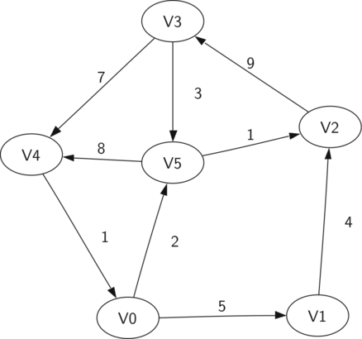
Transitive Closure
Example of bus route:
To determine if V0 can reach V3, a graph traversal must be performed.

Slide 20
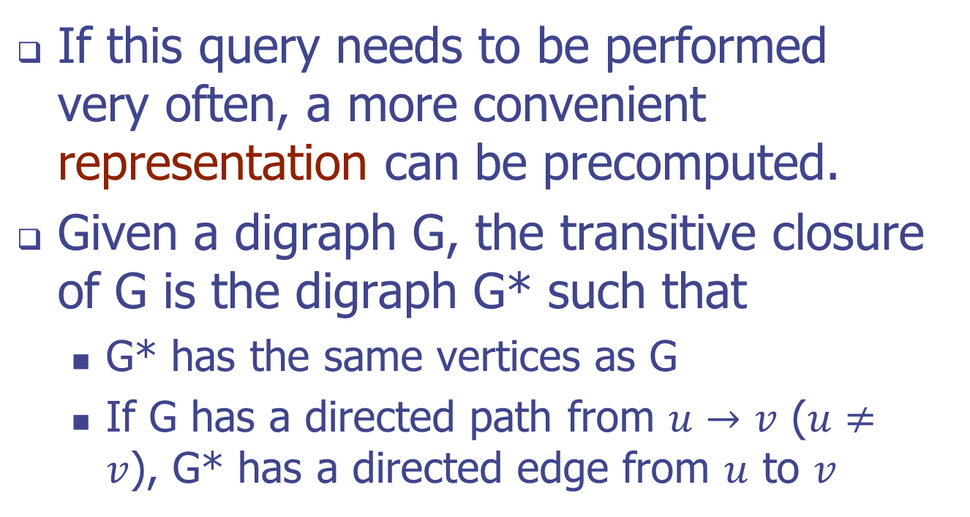
Transitive Closure
If this query needs to be performed very often, a more convenient representation can be precomputed.
Given a digraph G, the transitive closure of G is the digraph G* such that
G* has the same vertices as G
If G has a directed path from $u→v$ ($u≠v$), G* has a directed edge from $u$ to $v$

Slide 21
Transitive Closure
In other words,
If there is a path between two vertices (that may consist of multiple edges)
Then, there is a directed edge between the two vertices in the modified graph, G*.

Slide 22
Example
D
E
B
G
C
A
D
E
B
C
A
G*

Slide 23
Example
D
E
B
G
C
A
D
E
B
C
A
G*

Slide 24
Example
D
E
B
G
C
A
D
E
B
C
A
G*

Slide 25
Example
D
E
B
G
C
A
D
E
B
C
A
G*

Slide 26
Example
D
E
B
G
C
A
D
E
B
C
A
G*

Slide 27
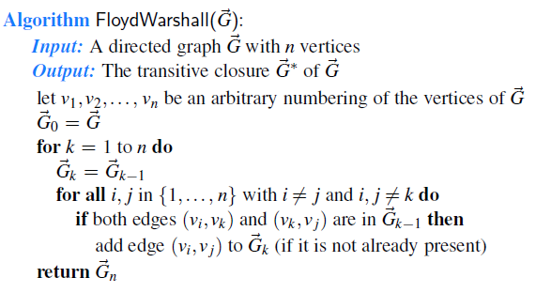
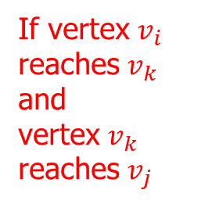

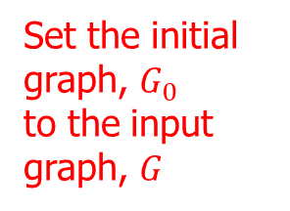
Transitive Closure
Can use the Floyd-Warshall algorithm to compute
Assign a number to each vertex
Set the initial graph, $G_{0}$ to the input graph, $G$
Repeat for every vertex
Generate sub-graph for the current vertex, $v_{k}$
If vertex $v_{i}$ reaches $v_{k}$ and vertex $v_{k}$ reaches $v_{j}$

Slide 28




Transitive Closure – Simple Example
$$k=1$$
4
5
4
5
2
2
$$G_{0}$$
$$G_{1}$$
$$G_{0}$$
3
3
1
1

Slide 29

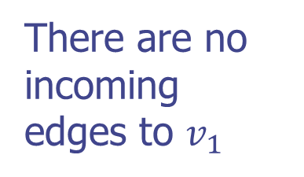

Transitive Closure – Simple Example
$$i,j∈\{1,2,3,4,5\}$$
There are no incoming edges to $v_{1}$
$$k=1$$
4
5
4
5
2
2
$$G_{0}$$
$$G_{1}$$
3
3
1
1

Slide 30




Transitive Closure – Simple Example
$$i,j∈\{1,2,3,4,5\}$$
There are no incoming edges to $v_{2}$
$$k=2$$
4
5
4
5
2
2
$$G_{1}$$
$$G_{2}$$
3
3
1
1

Slide 31

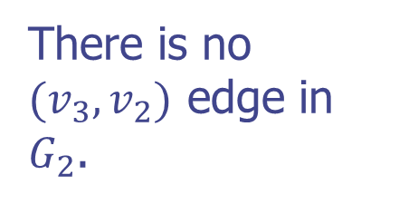


Transitive Closure – Simple Example
$$i,j∈\{1,2,3,4,5\}$$
There is no $(v_{3},v_{2})$ edge in $G_{2}$.
$$k=3$$
4
5
4
5
2
2
$$G_{2}$$
$$G_{3}$$
3
3
1
1

Slide 32
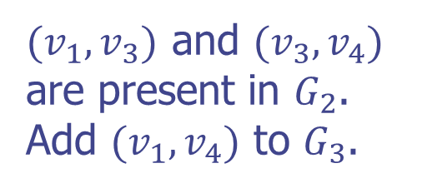
Transitive Closure – Simple Example
$$i,j∈\{1,2,3,4,5\}$$
$(v_{1},v_{3})$ and $(v_{3},v_{4})$ are present in $G_{2}$. Add $(v_{1},v_{4})$ to $G_{3}$.
Complete the remaining steps on your own.
$$k=3$$
4
5
4
5
2
2
$$G_{2}$$
$$G_{3}$$
3
3
1
1

Slide 33
Floyd-Warshall Example
BOS
ORD
v
4
JFK
v
2
v
6
SFO
DFW
LAX
v
v
3
1
MIA
v
5

Slide 34
Floyd-Warshall, Iteration 1
BOS
ORD
v
4
JFK
v
2
v
6
SFO
DFW
LAX
v
v
3
1
MIA
v
5

Slide 35
Floyd-Warshall, Iteration 2
BOS
ORD
v
4
JFK
v
2
v
6
SFO
DFW
LAX
v
v
3
1
MIA
v
5

Slide 36
Floyd-Warshall, Iteration 3
BOS
ORD
v
4
JFK
v
2
v
6
SFO
DFW
LAX
v
v
3
1
MIA
v
5

Slide 37
Floyd-Warshall, Iteration 4
BOS
ORD
v
4
JFK
v
2
v
6
SFO
DFW
LAX
v
v
3
1
MIA
v
5

Slide 38
Floyd-Warshall, Iteration 5
BOS
ORD
v
4
JFK
v
2
v
6
SFO
DFW
LAX
v
v
3
1
MIA
v
5

Slide 39
Floyd-Warshall, Iteration 6
BOS
ORD
v
4
JFK
v
2
v
6
SFO
DFW
LAX
v
v
3
1
MIA
v
5

Slide 40
Floyd-Warshall, Conclusion
BOS
ORD
v
4
JFK
v
2
v
6
SFO
DFW
LAX
v
v
3
1
MIA
v
5

Slide 41
End of Part 3

